Slide 1
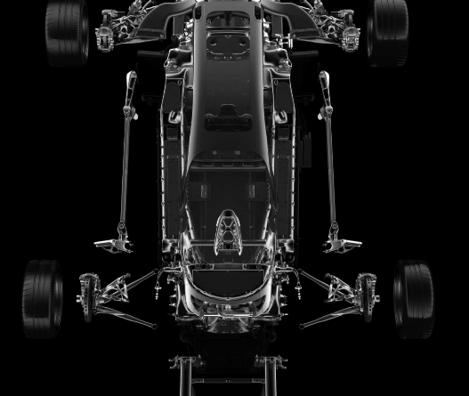
Capstone Project : Automotive Industry
Group B-3 Aman Bhardwaj Priya Bhardwaj Tanisha Jain Satyam Sharma

Slide 2
Content
Problem Statement Discussion
Challenges
Task 3

Slide 3
Problem statement
XYZ company aspires to enter the US used car market
Based on the dataset of different types of used cars across the market:
List the output of exploratory analysis.
Highlight important outcomes/findings from the data by descriptive analysis.
Build an appropriate predictive model for predicting the price of a used car.

Slide 4
Challenge
Problem faced by the Company
The XYZ Company want to understand the factors affecting the pricing of cars in the market, since those may be very different from the new car market. Essentially, the company wants to know:
Which variables are significant in predicting the price of a used car?
How well those variables describe the price of a car?

Slide 5
3.1
Data Analysis using Big Data Tools(HDFS, HIVE and PySpark)
3.2
Data Analysis on Cloud(AWS)
3.3
Deployment of Model using Flask

Slide 6

Data Analysis Using Big Data Tools

Slide 7
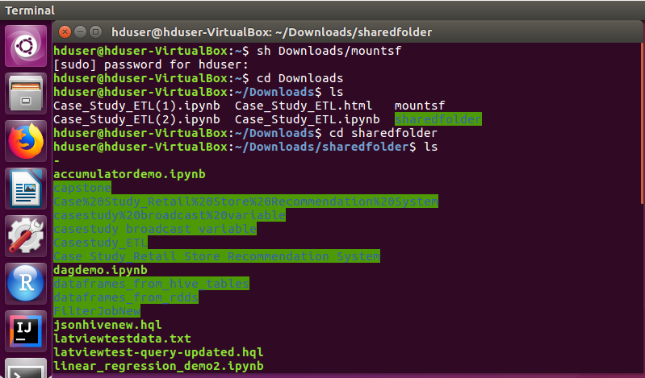
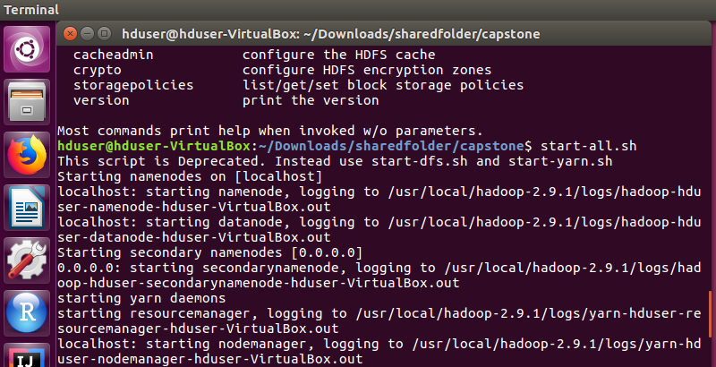
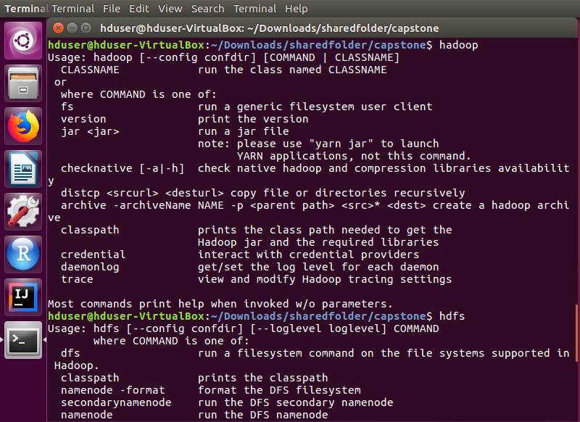
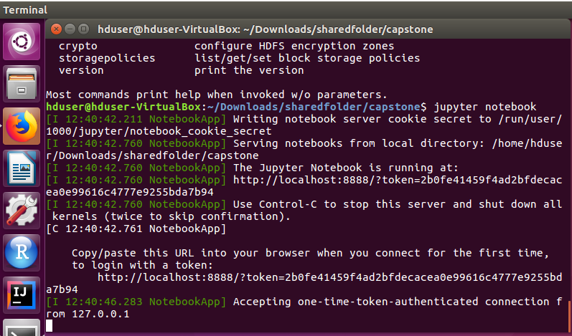
Initializing

Slide 8
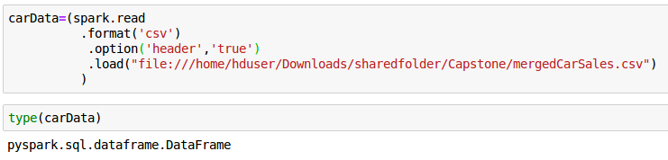
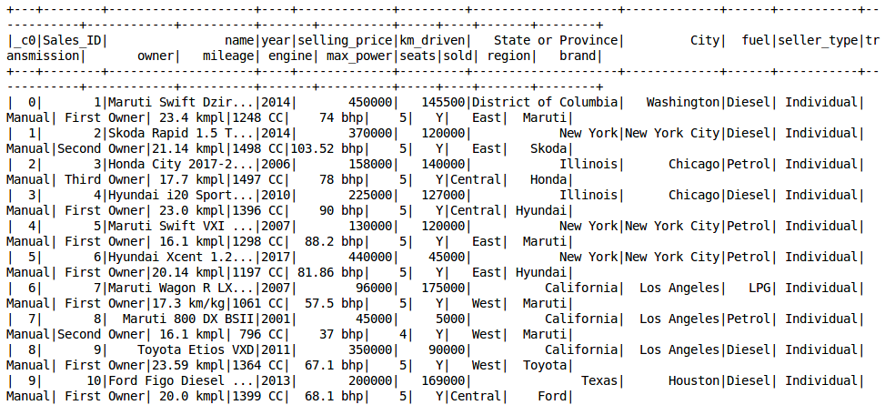
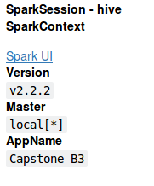
PySpark Initialization and Data Loading

Slide 9
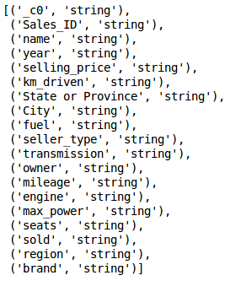
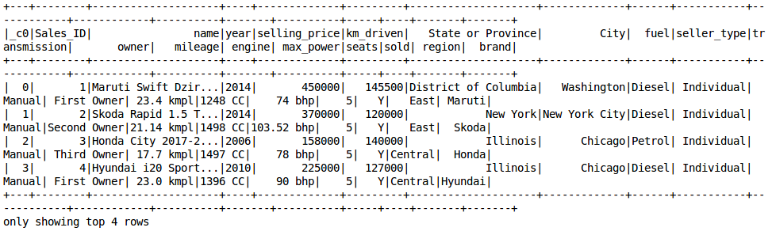
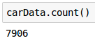
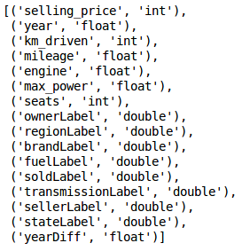
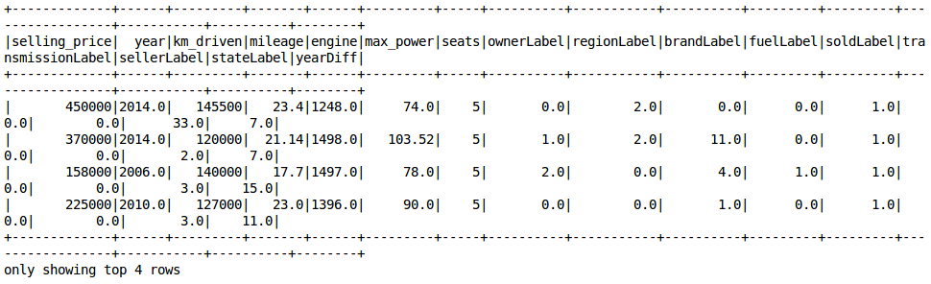
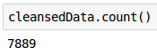
Cleaning, Handling Missing Data and Data Transformation

Slide 10
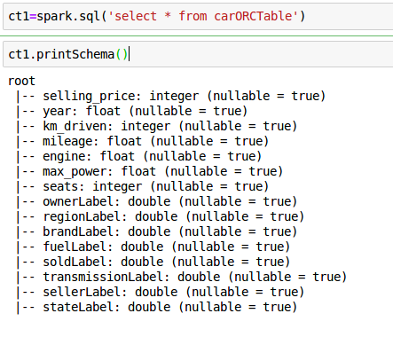
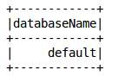
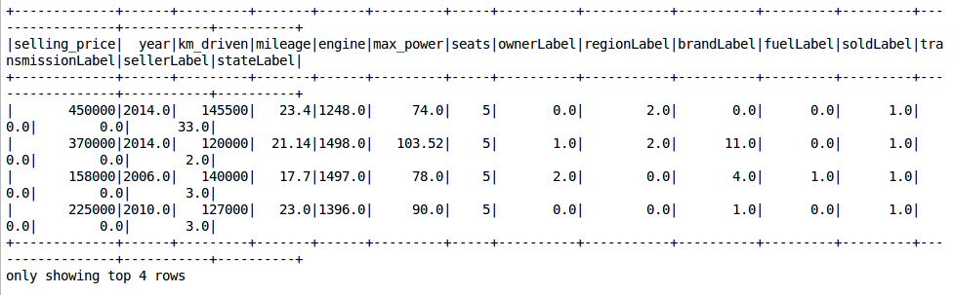
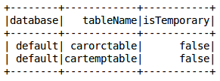
Loading Data on Spark Data Frame and saving it to Hive tables on a Hadoop Cluster

Slide 11
Machine Learning in PySpark
Root Mean Square Error:
Mean Absolute Error:
R2 Score:
Using Random Forest Regression:
Label → Selling Price.
Train-Test Split → 70-30
Max Bins → 200

Slide 12
Machine Learning (continued)
Root Mean Square Error:
Mean Absolute Error:
R2 Score:
Using Decision Tree Regression:
Label → Selling Price.
Train-Test Split → 70-30
Max Bins → 100

Slide 13
Machine Learning (continued)
Root Mean Square Error:
Mean Absolute Error:
R2 Score:
Using Linear Regression:
Label → Selling Price.
Train-Test Split → 70-30
Max Iteration → 10
Regression Parameter → 0.01 (Ridge)

Slide 14

Data Analysis on Cloud (AWS)

Slide 15
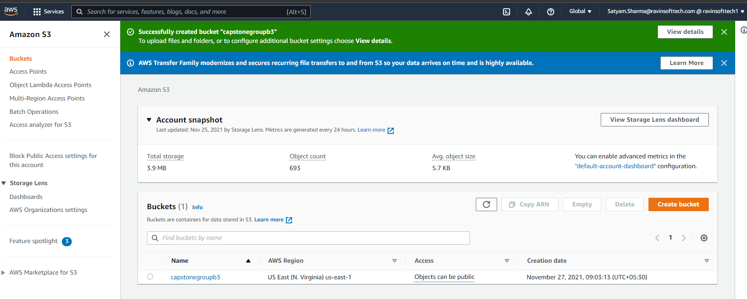
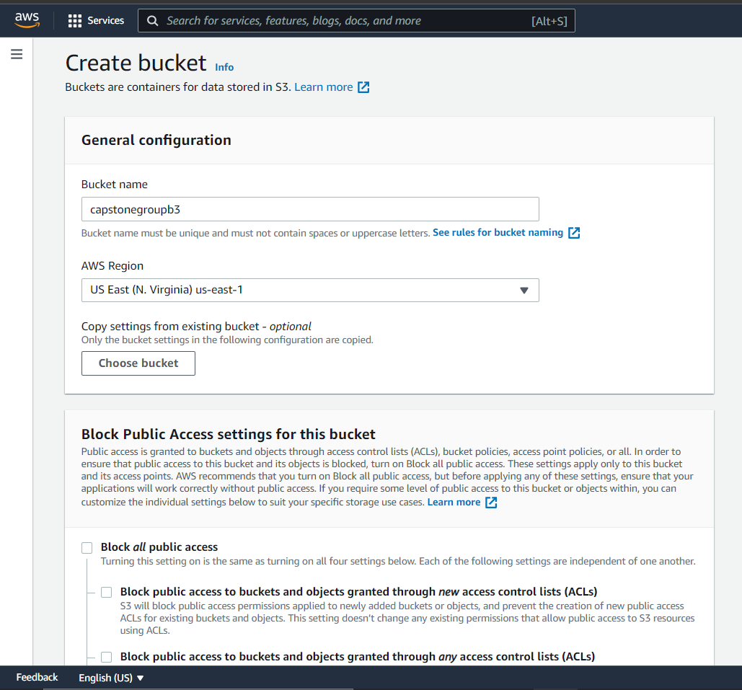
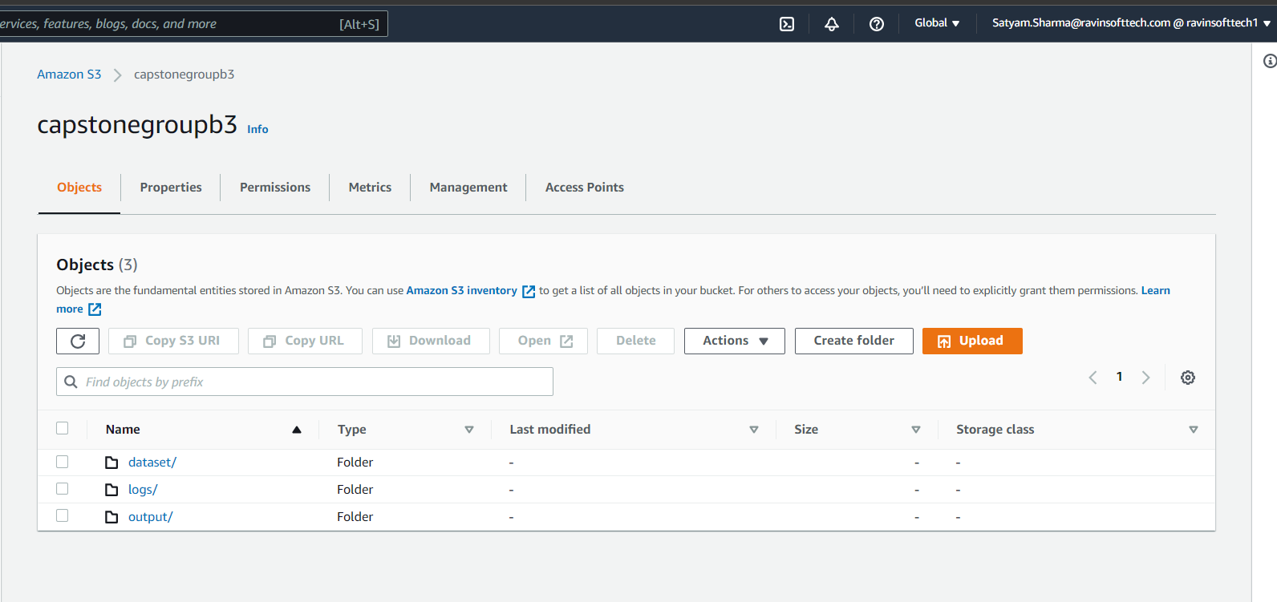
Bucket and Folder Creation

Slide 16
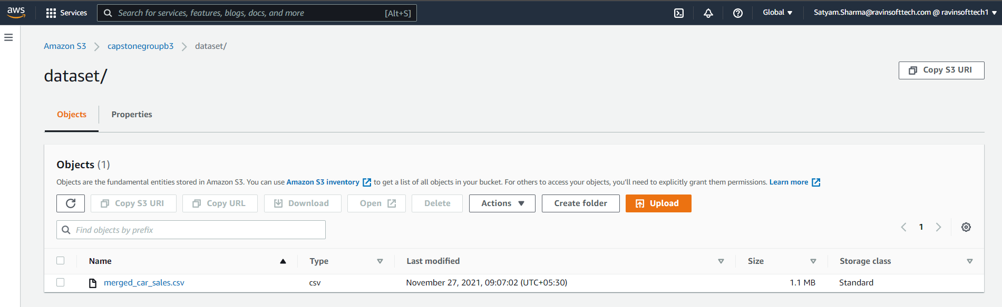
Data File Upload in S3

Slide 17
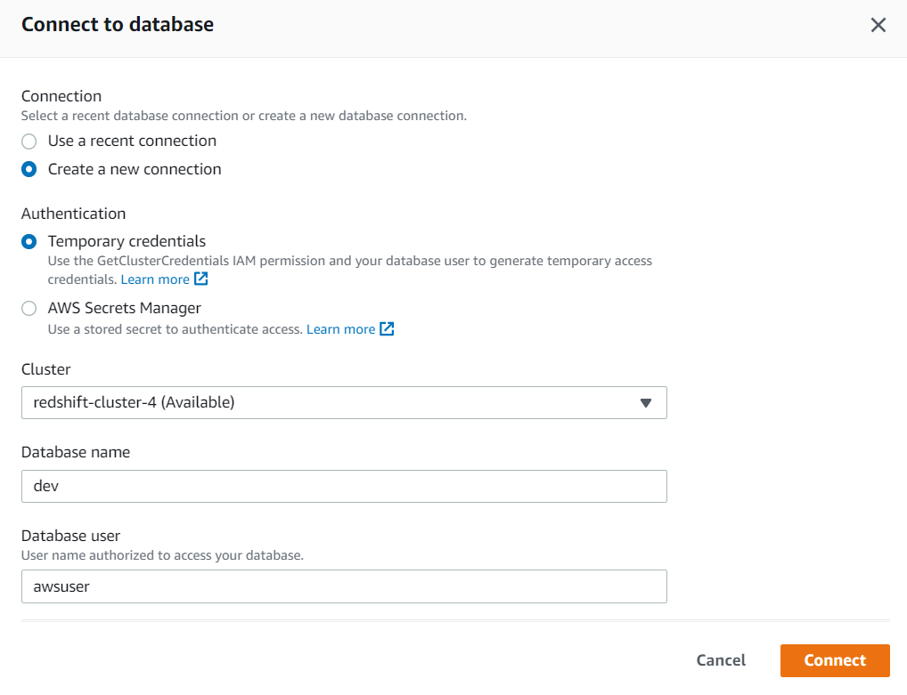
Redshift Connection

Slide 18
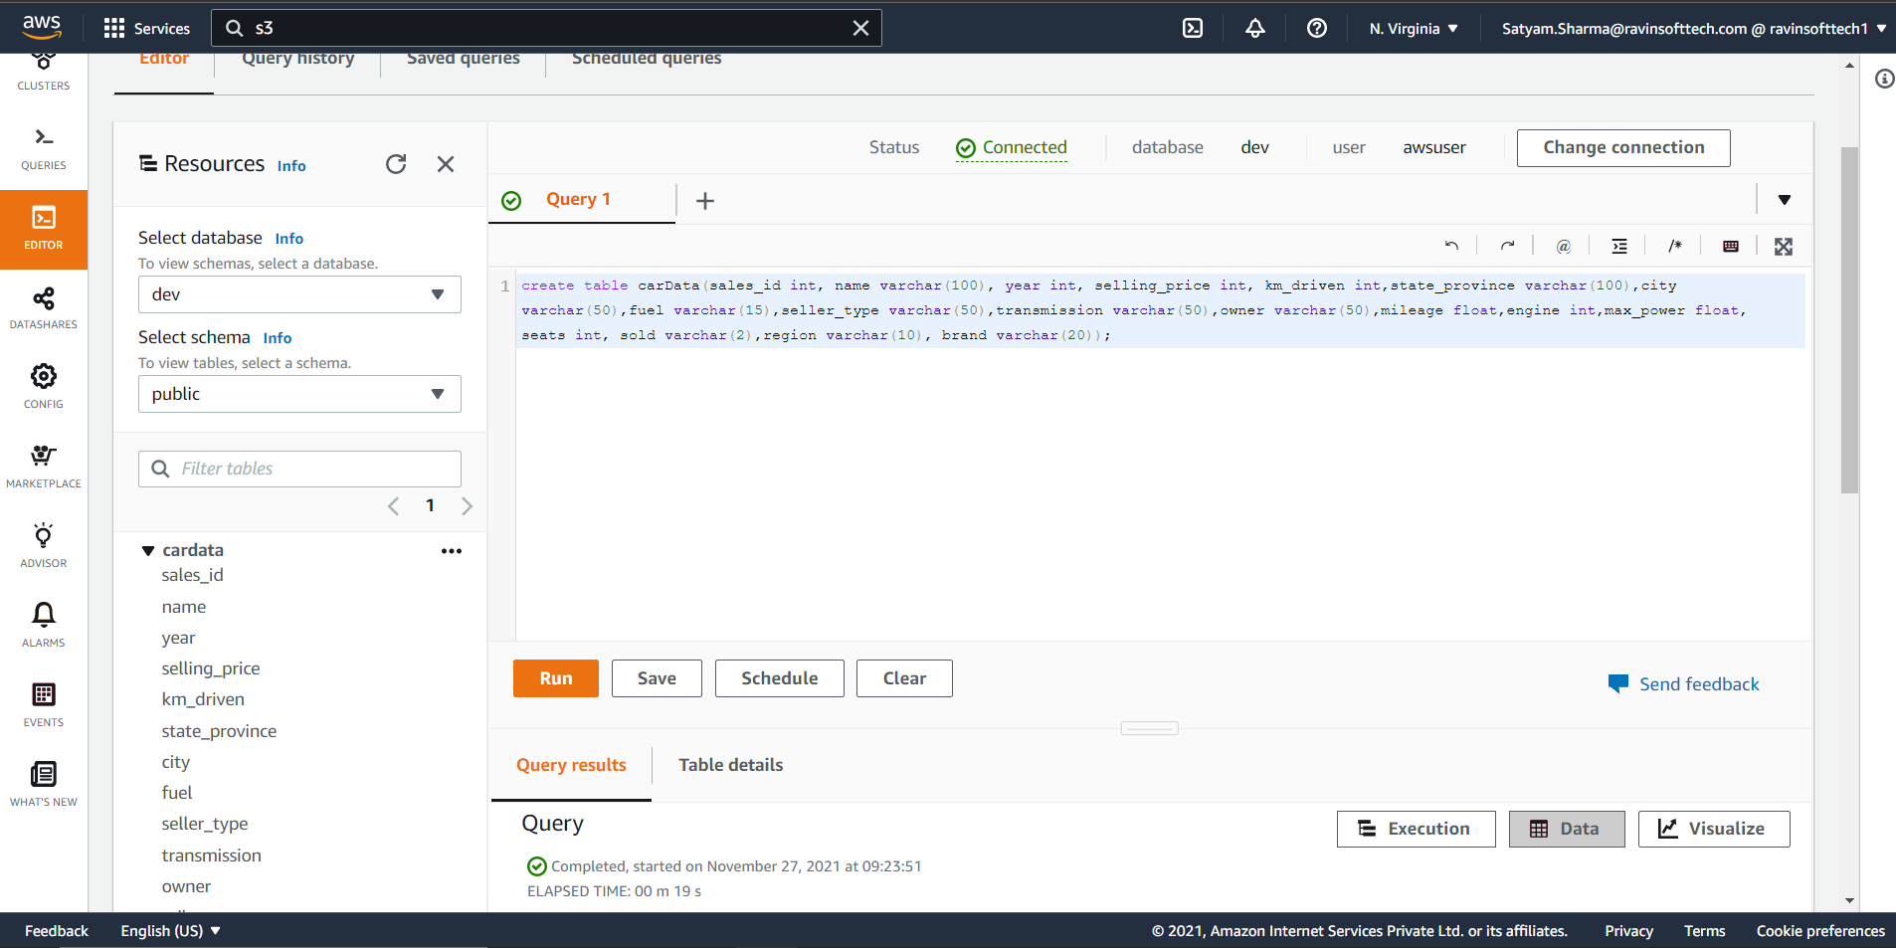
Table creation in Redshift

Slide 19
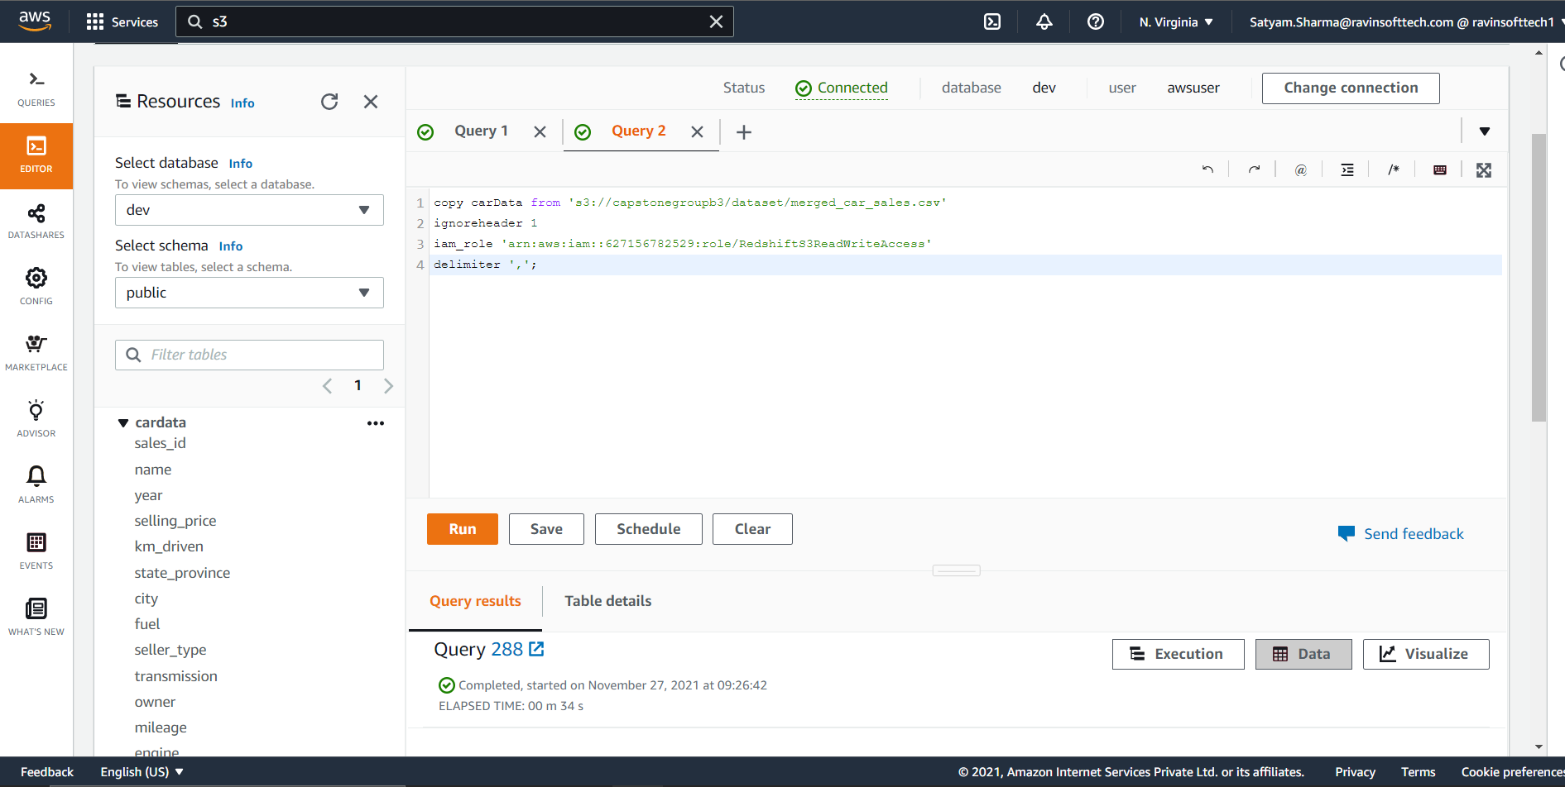
Copying Data from S3 to Redshift

Slide 20
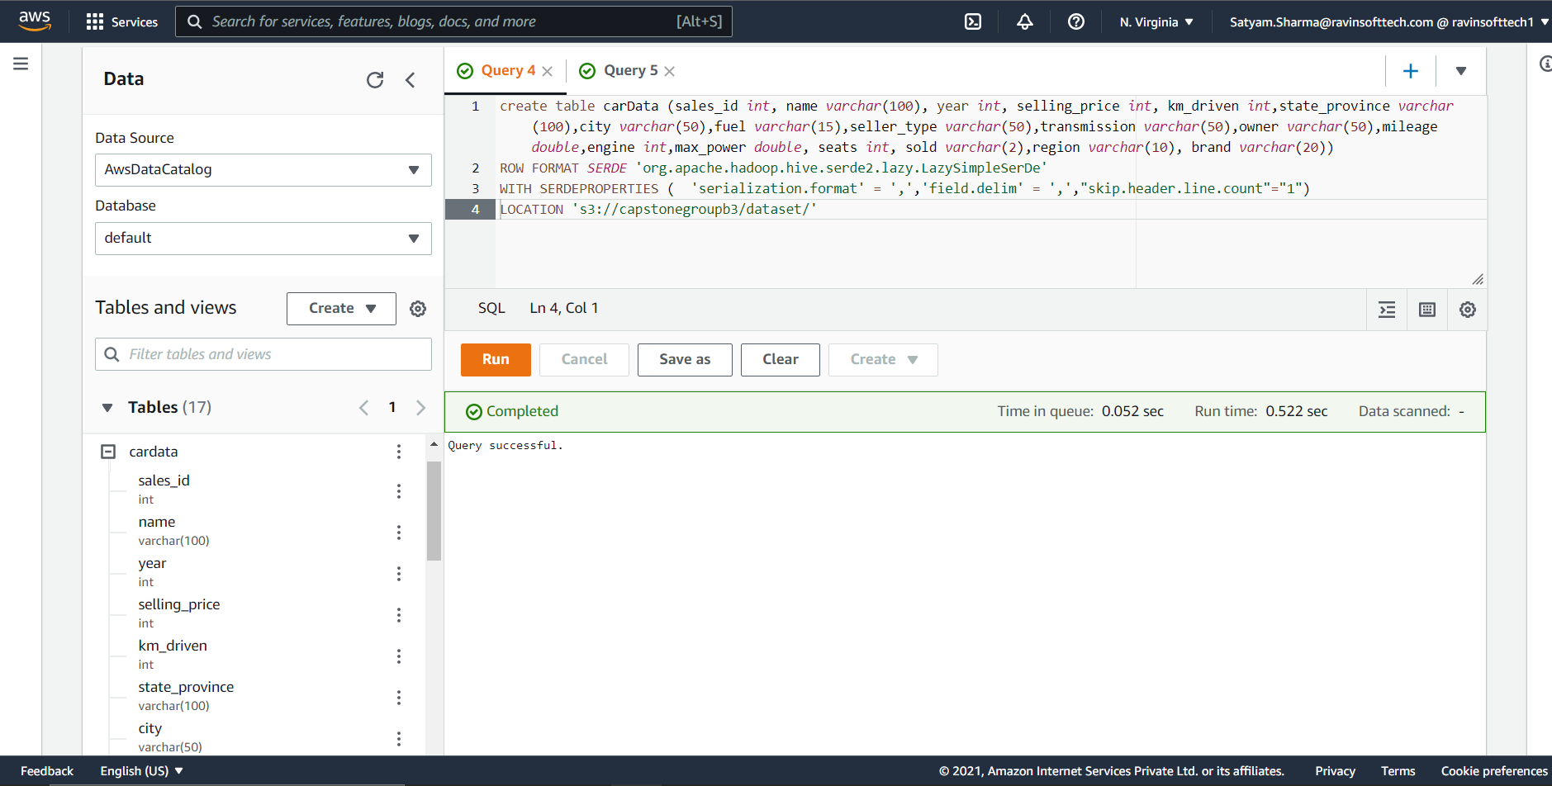
Creating and Loading Data in Athena

Slide 21
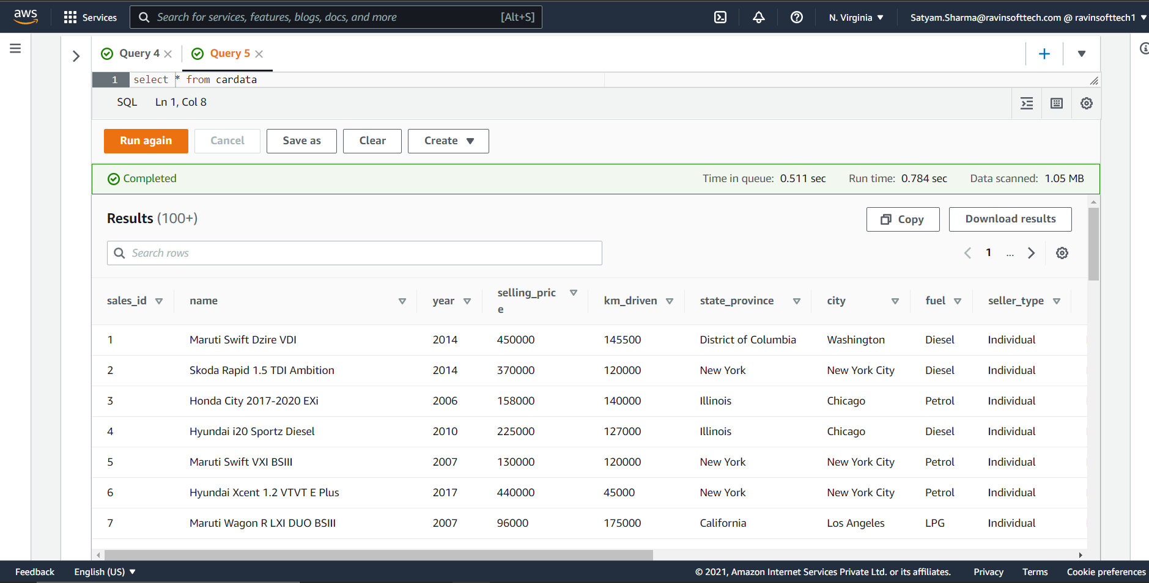
Query result in Athena

Slide 22
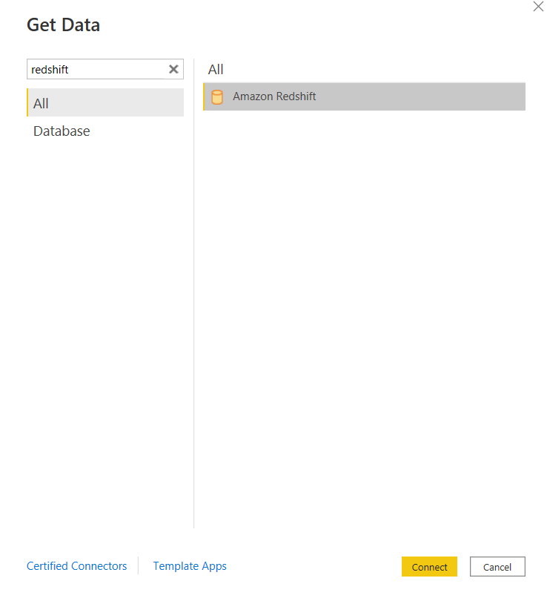
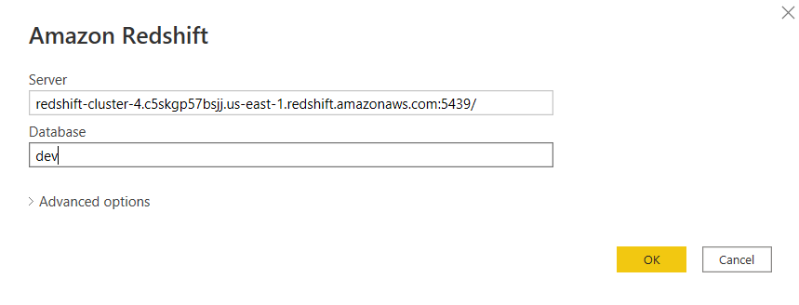
Connecting to Power BI using Redshift

Slide 23
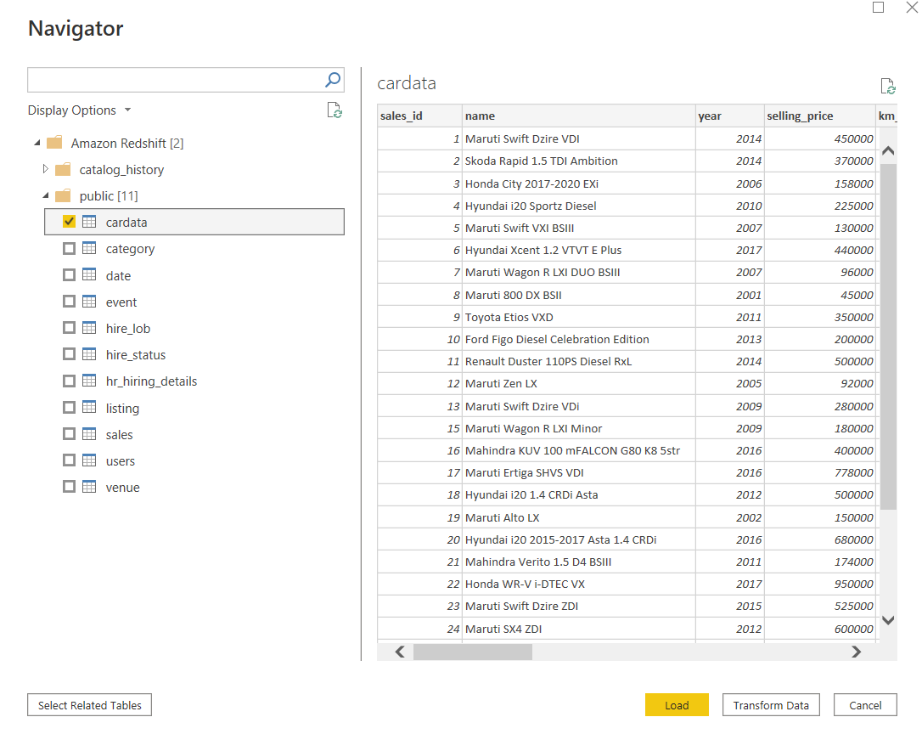
Loading Data in Power BI

Slide 24

Storytelling using Power BI

Slide 25
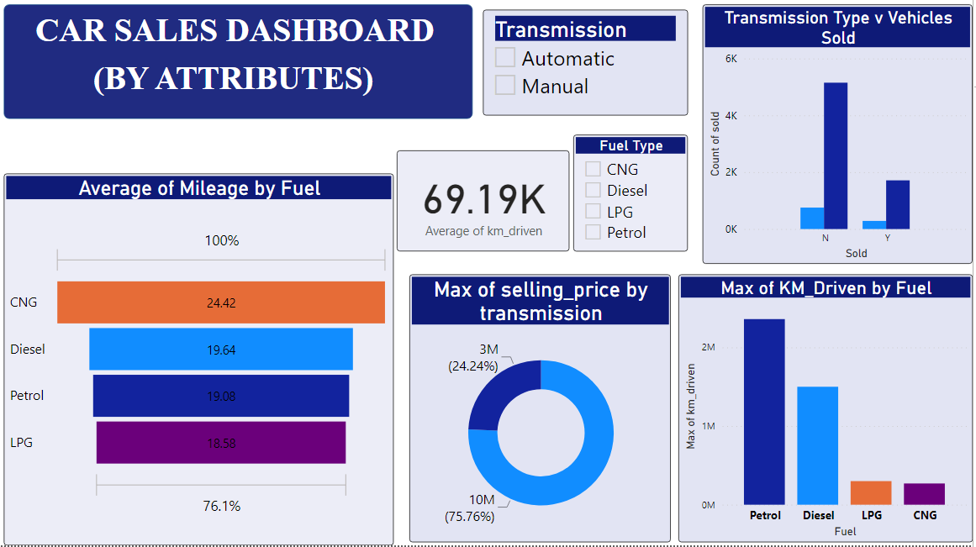

Slide 26
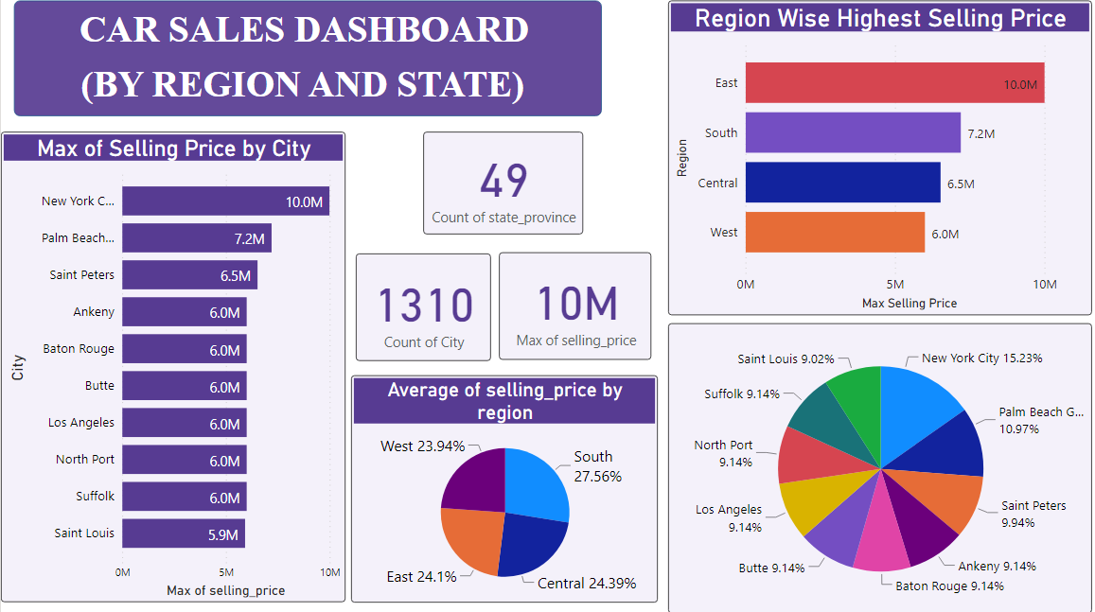

Slide 27
Deployment of ML Model using Flask

Slide 28
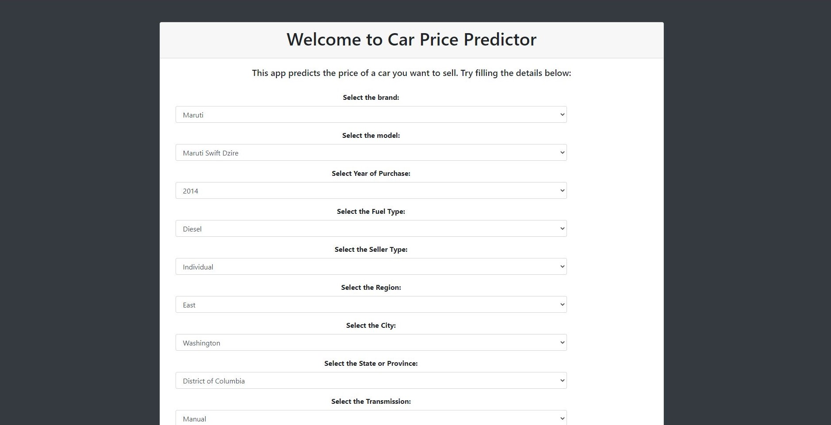

Slide 29
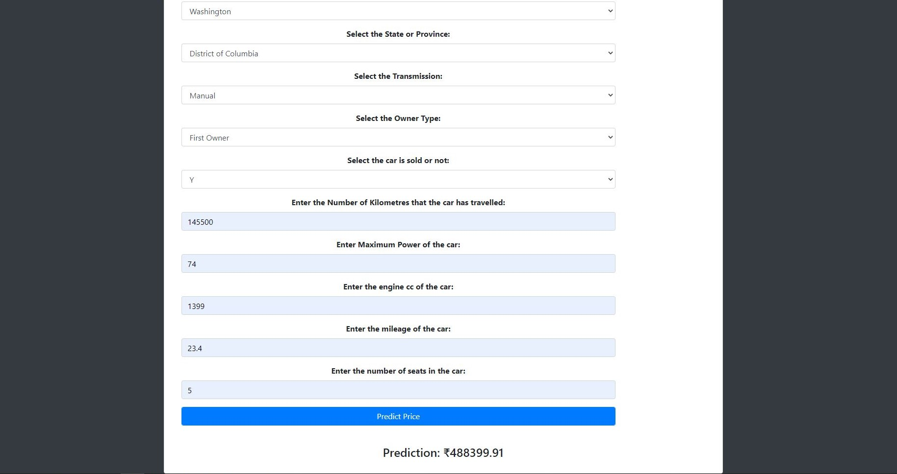

Slide 30
Thank You

